Slide 1
Topic-6
Chapter 7 : Inventory and Warehouse Management Process
Magal and Word | Integrated Business Processes with ERP Systems | © 2011

Slide 2
Learning Objectives
Discuss the four goods movements associated with inventory management.
Describe the organizational levels in warehouse management.
Analyze the master data associated with warehouse management.
Identify and explain the key steps in the warehouse management processes.
Magal and Word | Integrated Business Processes with ERP Systems | © 2011

Slide 3
Learning Objectives
Demonstrate how inventory and warehouse management processes are integrated with other processes.
Effectively use SAP® ERP to execute the key steps in the warehouse management process.
Extract and analyze meaningful information about the warehouse management process utilizing SAP ERP.
Magal and Word | Integrated Business Processes with ERP Systems | © 2011

Slide 4
Background
Inventory and warehouse management processes are concerned with the storage and movement of material within an organization.
Topic-3 (procurement) introduced the underlying activity in inventory management (goods movement).
The four goods movements types are:
  Goods receipt
  Goods issue
  Stock transfer
  Transfer posting
Magal and Word | Integrated Business Processes with ERP Systems | © 2011

Slide 5
Background
Warehouse management – processes that enable companies to manage materials more effectively.
Linkages exist between inventory management and warehouse management.
Magal and Word | Integrated Business Processes with ERP Systems | © 2011

Slide 6
Inventory Management
Focus is on the extension of the goods movement.
Goods movement involves specific movement types.
  Information needed to execute the movements.
  General ledger accounts are affected.
The key organization level is storage location.
Most relevant master data:
  Material master
  Plant/data storage material master view
Magal and Word | Integrated Business Processes with ERP Systems | © 2011

Slide 7
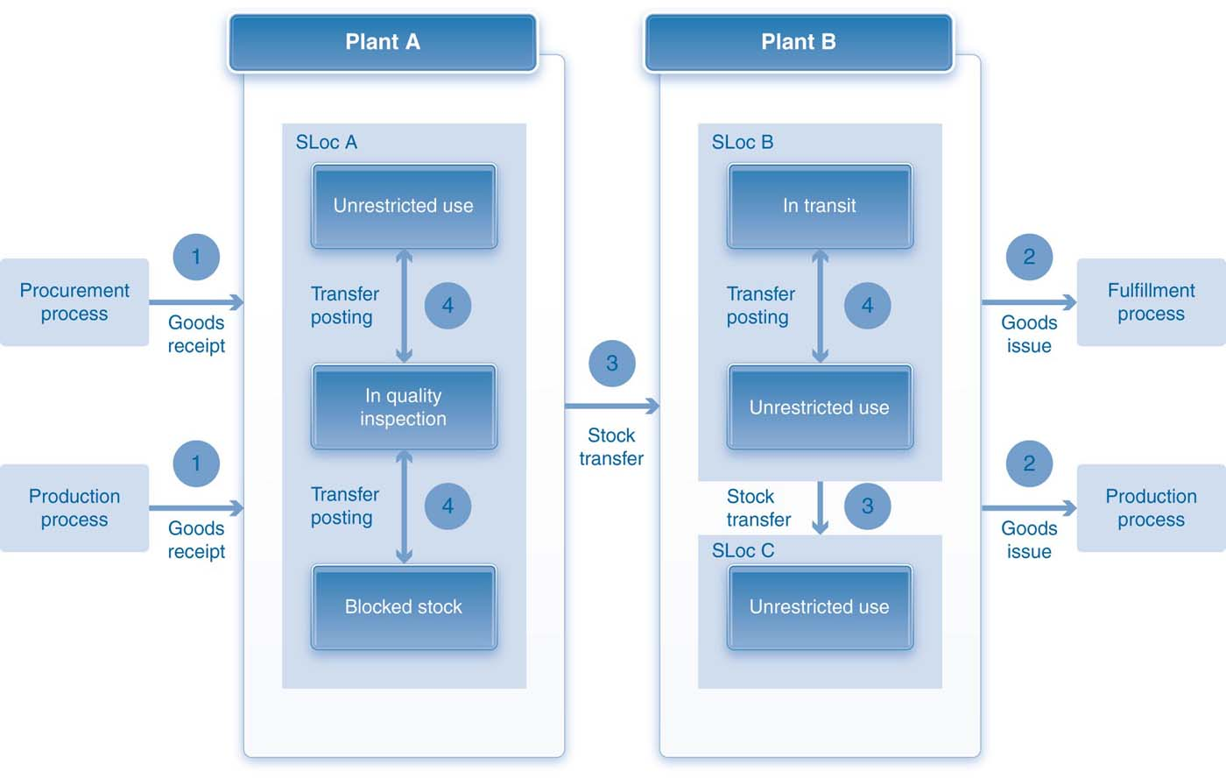
Goods Movements
Magal and Word | Integrated Business Processes with ERP Systems | © 2011

Slide 8
Goods Receipt
Movement of materials into inventory (increase)
Can take place during the production process
Can result in the creation of material and financial accounting documents for both production and IM-WM processes
Can post goods receipts without reference to an order
  Initial receipt of inventory
  Unplanned receipt
Magal and Word | Integrated Business Processes with ERP Systems | © 2011

Slide 9
Goods Issue
Results in a decrease in inventory
In the fulfillment process, it indicates a shipment of finished goods or trading goods to a customer against a sales order.
In the production process, it reflects the issuing of raw materials or semifinished goods to a production order.
Can be unplanned.
Materials may be withdrawn for internal consumption.
Magal and Word | Integrated Business Processes with ERP Systems | © 2011

Slide 10
Transfer Postings
Are used to change the status or type of materials in stock.
Four common stock statuses:
  Unrestricted use
  In quality inspection
  Blocked
  In transit
Can be used in other situations that do not necessarily involve a physical movement of materials.
Magal and Word | Integrated Business Processes with ERP Systems | © 2011

Slide 11
Stock Transfers
Used to physically move materials within the enterprise from one organizational level or location to another.
Three options are available for organizational levels:
  Between storage locations within one plant
  Between plants in one company code
  Between plants in different company codes
Magal and Word | Integrated Business Processes with ERP Systems | © 2011

Slide 12
Stock Transfers
Three options are available for moving material, regardless of the organizational level:
  One-step procedure
  Two-step procedure
  Stock transport order (STO)
Magal and Word | Integrated Business Processes with ERP Systems | © 2011

Slide 13
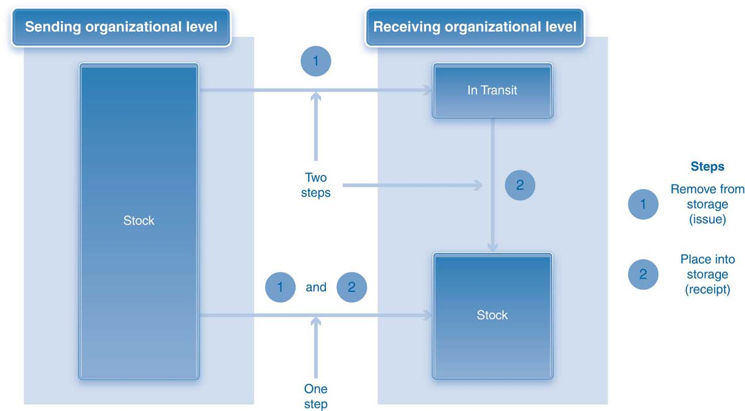
One-step and Two-step Procedures
Magal and Word | Integrated Business Processes with ERP Systems | © 2011

Slide 14
Storage Location-to-Storage Location Transfer
A transfer between two storage locations within the same plant
Reasons why:
  Temporary staging area
  Quality inspection
A one-step or a two-step procedure can be used.
  One-step procedure: materials can be in any stock status (supplying location) to any stock status in (receiving location).
  Two-step procedure: possible only when the materials are in unrestricted use at the supplying location.
Magal and Word | Integrated Business Processes with ERP Systems | © 2011

Slide 15
Storage Location-to-Storage Location Transfer
Transfer between storage locations in the same plant does not affect valuation (same valuation).
  No financial impact
  No financial document
Split valuation (when valuation is not the same)
  Financial impact
  Financial document
  Multiple material accounts
Magal and Word | Integrated Business Processes with ERP Systems | © 2011

Slide 16
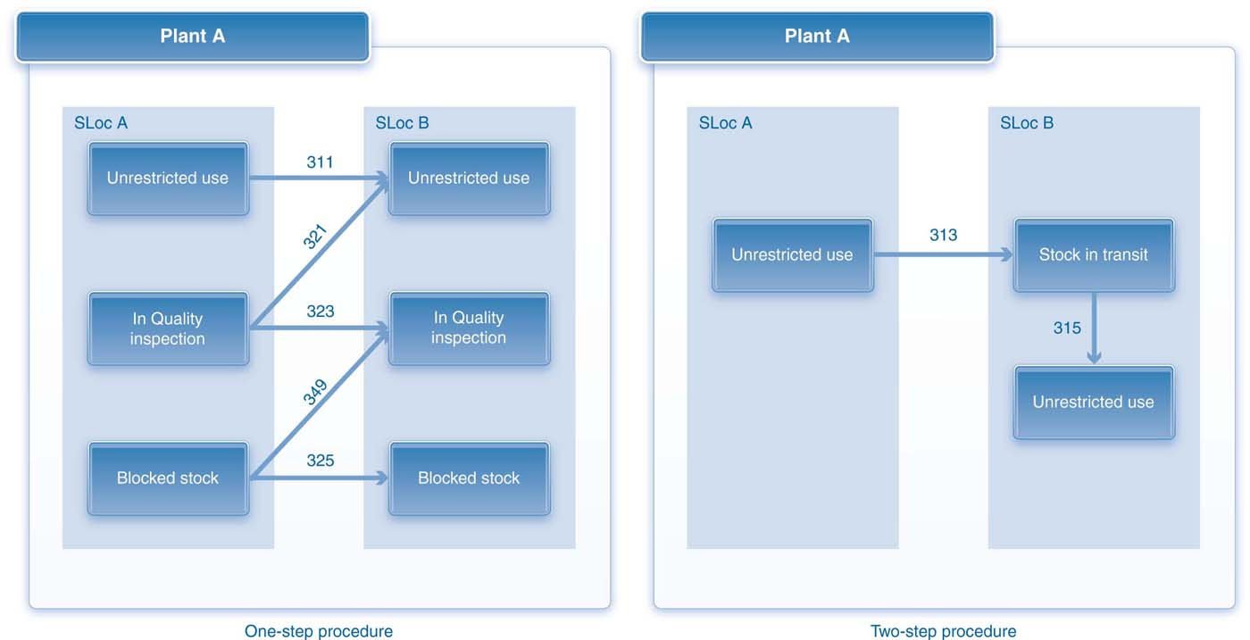
Stock Transfer within a Plant
Magal and Word | Integrated Business Processes with ERP Systems | © 2011

Slide 17
Plant-to-Plant Transfer
Movement of materials between two plants within the same company code
A one-step or a two-step procedure can be used.
  Difference is the stock status at the receiving plant.
Typically, only materials in the unrestricted use status can be moved between plants.
Material documents are created.
Financial impact (FI document)
Magal and Word | Integrated Business Processes with ERP Systems | © 2011

Slide 18
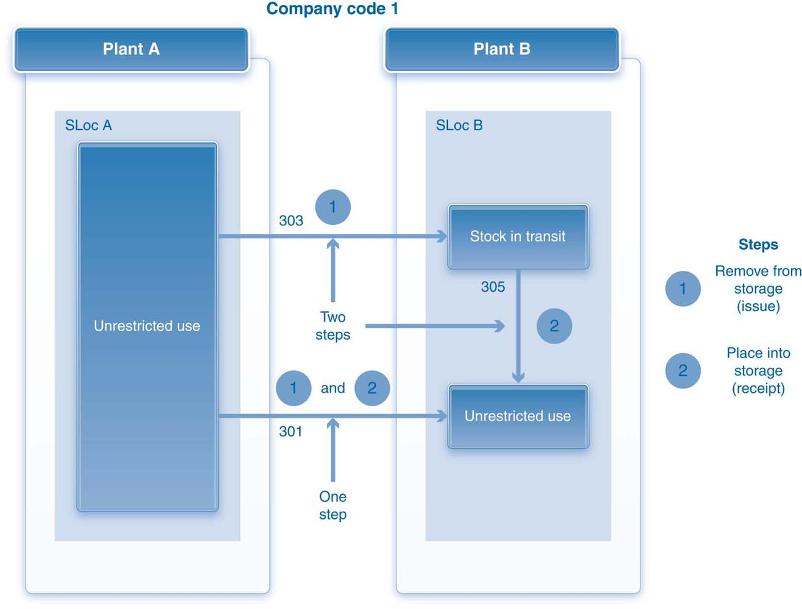
Plant-to-Plant Transfer
Magal and Word | Integrated Business Processes with ERP Systems | © 2011

Slide 19
Demo 7.1 Plant-to-Plant Stock Transfer (1 Step)
Review Plant-to-stock stock transfer (1 step)
Magal and Word | Integrated Business Processes with ERP Systems | © 2011

Slide 20
Company Code-to-Company Code Transfer
Movement of materials between two plants in different company codes
A one-step or a two-step procedure can be used
Two FI documents are created, one for each company code
  One line item is for the material account.
  One line item is for a clearing account created to accommodate such a transfer.
Magal and Word | Integrated Business Processes with ERP Systems | © 2011

Slide 21
Stock Transport Orders
Plant-to-plant movements have limitations.
Stock transport orders are a solution.
In the STO process one plant “purchases” the materials and another plant “sells” them.
Can involve steps from the procurement, fulfillment, and inventory management processes.
There types of stock transport orders:
  Stock transport orders without delivery
  Stock transport orders with delivery
  Stock transport orders with delivery and billing
Magal and Word | Integrated Business Processes with ERP Systems | © 2011

Slide 22
Stock Transport Orders without Delivery
Involve steps from purchasing and inventory management
STO created directly or referenced to other documents (PR)
Only the two-step procedure can be used
Material document created to record movement
Goods receipt recorded against the STO
One or two FI documents may be created
Financial impact
General ledger accounts
  Material accounts
  Clearing accounts
Magal and Word | Integrated Business Processes with ERP Systems | © 2011

Slide 23
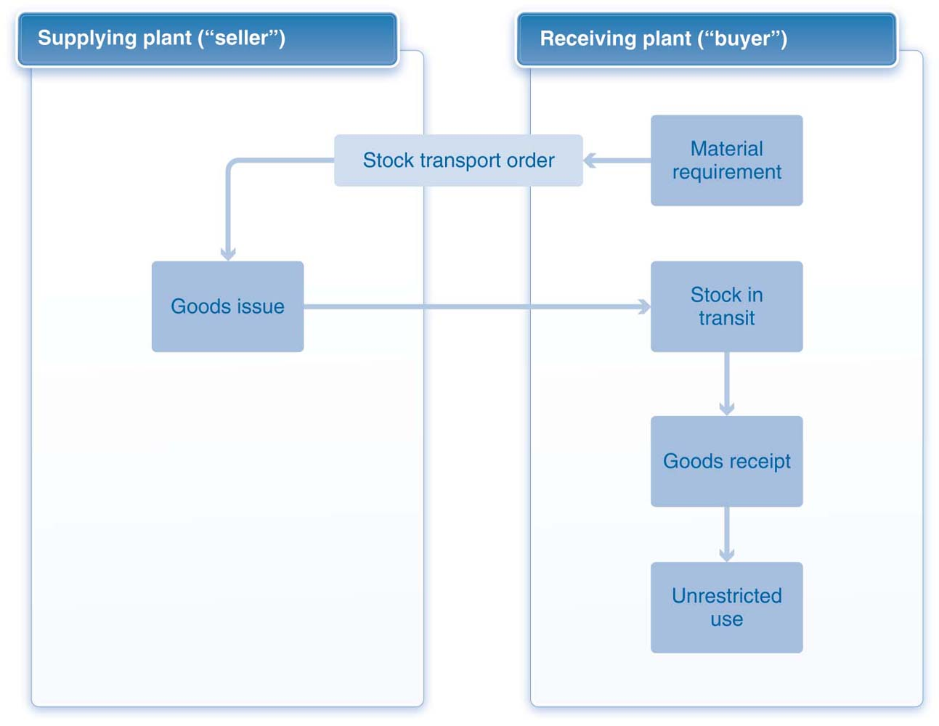
Stock Transport Orders without Delivery
Magal and Word | Integrated Business Processes with ERP Systems | © 2011

Slide 24
Demo 7.2: Stock Transport Order without Delivery
Review stock transport order without delivery
Magal and Word | Integrated Business Processes with ERP Systems | © 2011

Slide 25
Stock Transport Orders with Delivery
Delivery document is created (picking and packing) prior to goods issue.
The order is treated like a sales order.
A one-step or a two-step procedure can be used.
  One-step procedure: Only one material document is created, and the materials are placed in unrestricted use at the receiving plant.
  Two-step procedure: Material movement and financial impact are identical to those associated with an STO without delivery.
Magal and Word | Integrated Business Processes with ERP Systems | © 2011

Slide 26
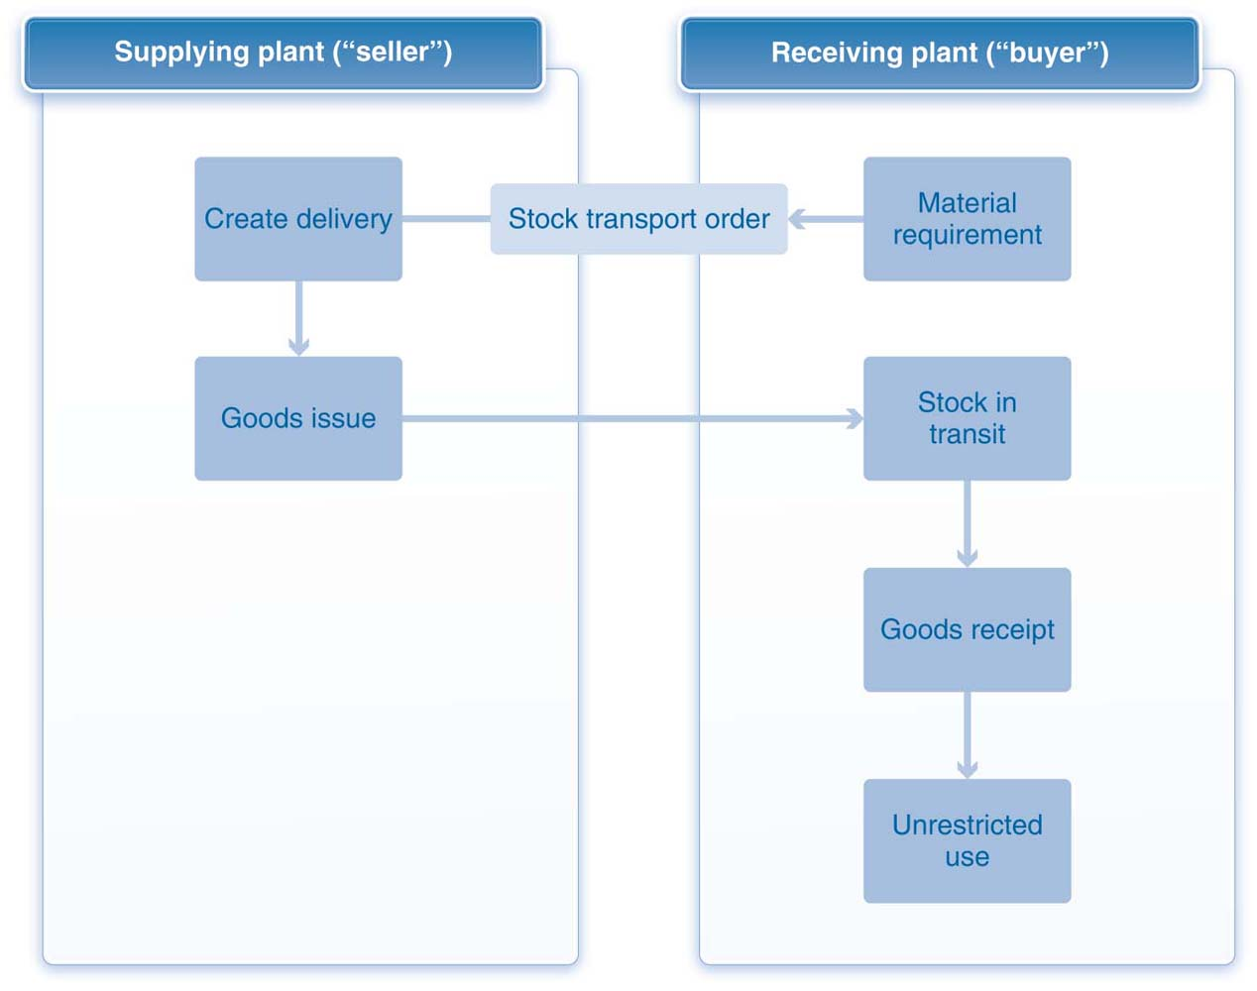
Stock Transport Orders with Delivery
Magal and Word | Integrated Business Processes with ERP Systems | © 2011

Slide 27
Demo 7.3: Stock Transport Order with Delivery
Review stock transport order with delivery
Magal and Word | Integrated Business Processes with ERP Systems | © 2011

Slide 28
Stock Transport Orders with Delivery and Billing
STO includes both the delivery document (shipping step) and the billing step from the fulfillment process at the sending plant.
STO includes the invoice verification step from the procurement process at the receiving plant.
Purchase price is included in the STO based on pricing conditions and info records.
The supplying plant creates a delivery document authorizing the shipment.
Goods issue is posted at the sending plant.
Goods receipt is posted at the receiving plant.
Magal and Word | Integrated Business Processes with ERP Systems | © 2011

Slide 29
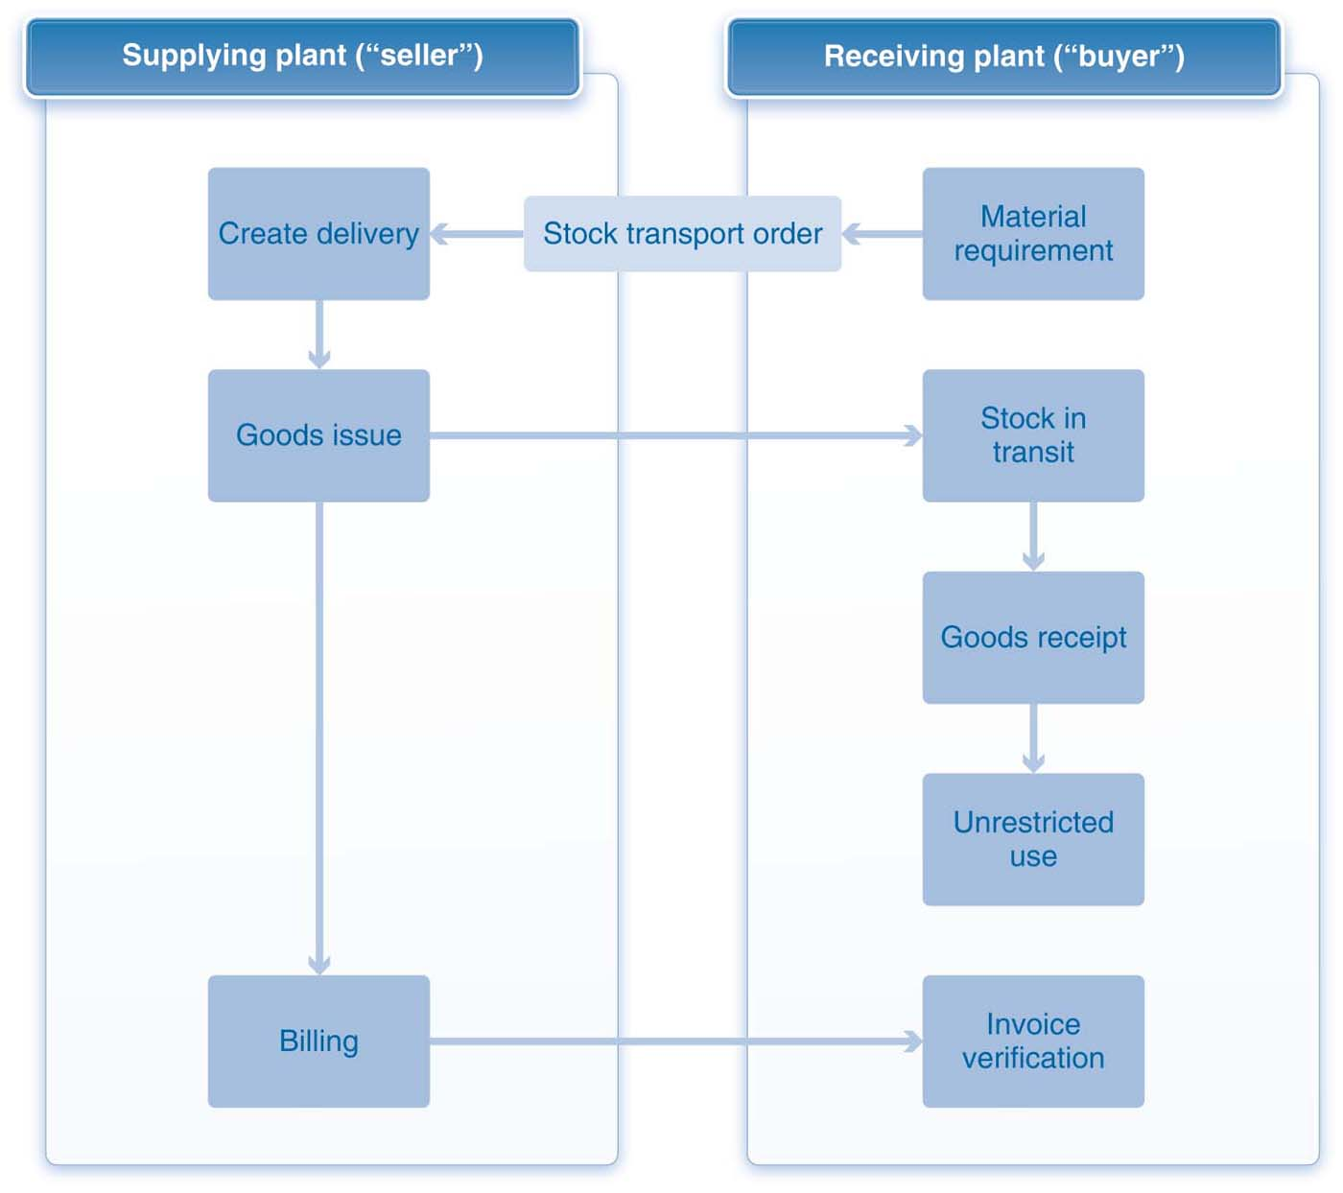
Stock Transport Order with Delivery and Billing
Magal and Word | Integrated Business Processes with ERP Systems | © 2011

Slide 30
Organizational Data in WM
Key organizational data are the warehouse.
Warehouse is associated with one or multiple combinations of plant and storage location.
Association between storage locations and a warehouse provides the linkage between IM processes and WM processes.
Magal and Word | Integrated Business Processes with ERP Systems | © 2011

Slide 31
Organizational Data in WM
When linking warehouses to storage locations, the following rules apply:
  A warehouse must be linked to at least one storage location.
  A warehouse can be linked to storage locations across multiple plants.
  A storage location can be linked to only one warehouse.
  Not all storage locations must be linked to a warehouse.
Magal and Word | Integrated Business Processes with ERP Systems | © 2011

Slide 32
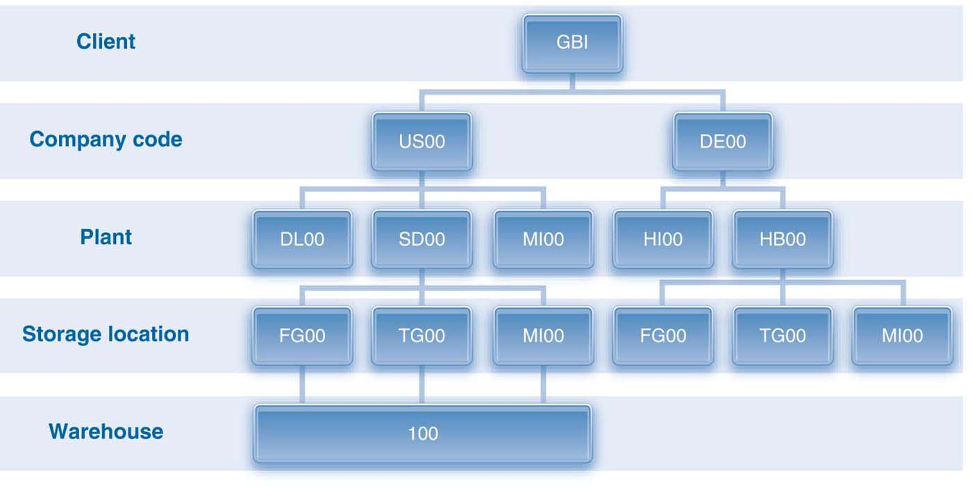
Organizational Data in Warehouse Management
Magal and Word | Integrated Business Processes with ERP Systems | © 2011

Slide 33
Organizational Data In WM
A warehouse is divided into smaller areas in a hierarchical manner
Storage type
Storage section/picking area
Storage bin
Magal and Word | Integrated Business Processes with ERP Systems | © 2011

Slide 34
Storage Type
Storage type is a division of a warehouse based on the characteristics of the space, materials, or activity.
Storage types can also be based on how materials are stored or on material specification.
The assignment of storage locations to a warehouse links IM activities to WM activities.
Interim storage areas represent the physical links between IM and WM.
Magal and Word | Integrated Business Processes with ERP Systems | © 2011

Slide 35
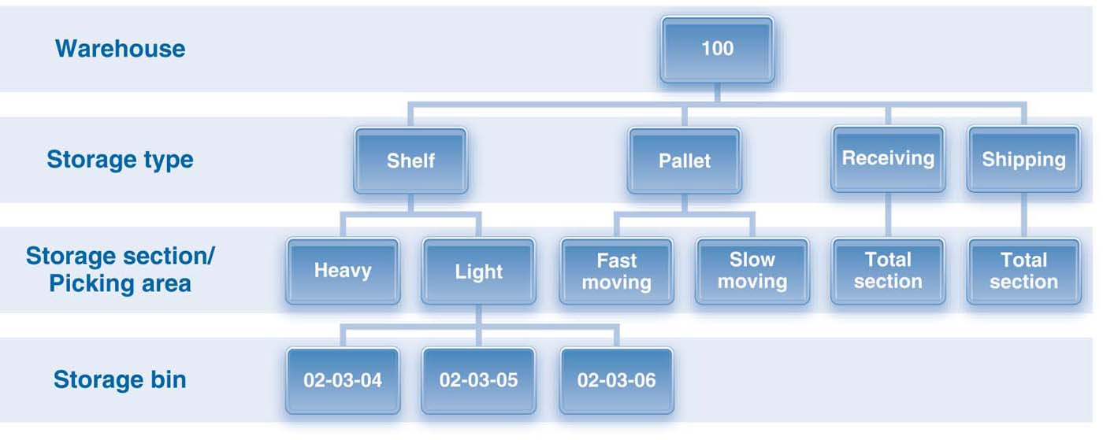
Structure of a Warehouse
Magal and Word | Integrated Business Processes with ERP Systems | © 2011

Slide 36
Storage Section
A storage section groups bins with similar characteristics:
  Fast-moving
  Slow-moving
  Heavy
  Light
  Small
Each storage type must have at least one storage section.
Magal and Word | Integrated Business Processes with ERP Systems | © 2011

Slide 37
Picking Area
A picking area is a division of a storage area based on removing or picking materials.
Storage bins are grouped based on similar picking strategies.
  Specific employees who are authorized to pick from specific bins
  A delivery can be allocated to multiple picking areas to facilitate parallel picking.
Magal and Word | Integrated Business Processes with ERP Systems | © 2011

Slide 38
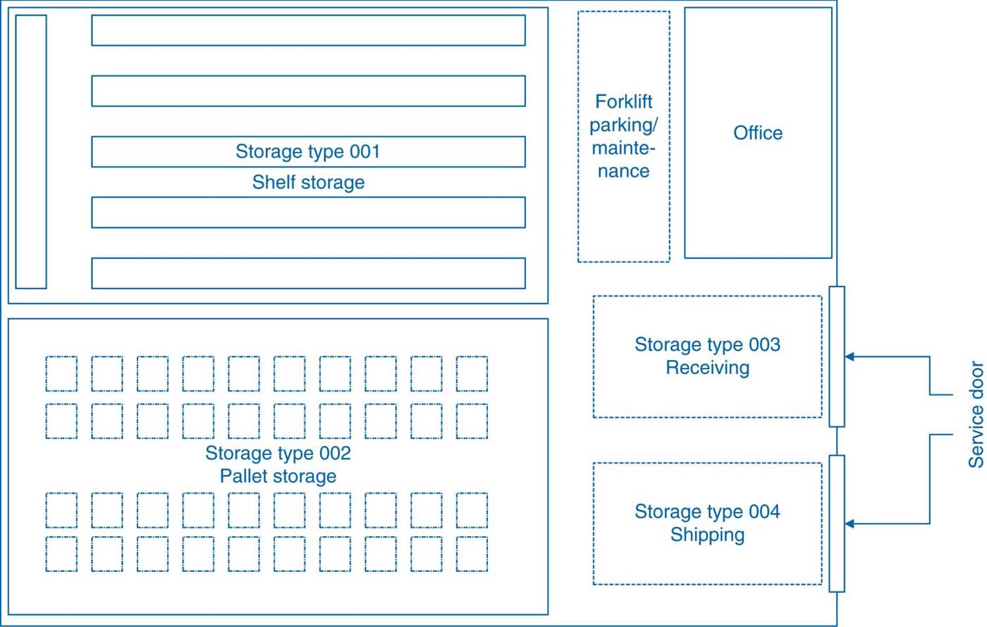
GBI’s San Diego Plant Layout
Magal and Word | Integrated Business Processes with ERP Systems | © 2011

Slide 39
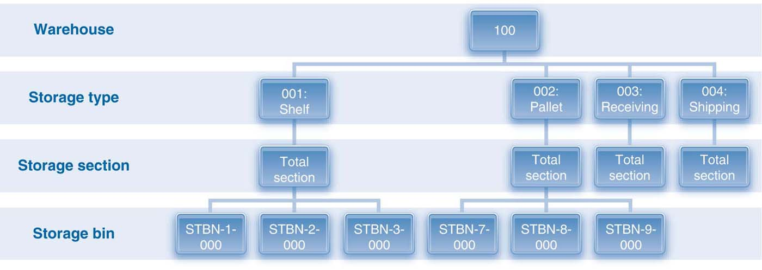
Structure of GBI’s Warehouse in San Diego
Magal and Word | Integrated Business Processes with ERP Systems | © 2011

Slide 40
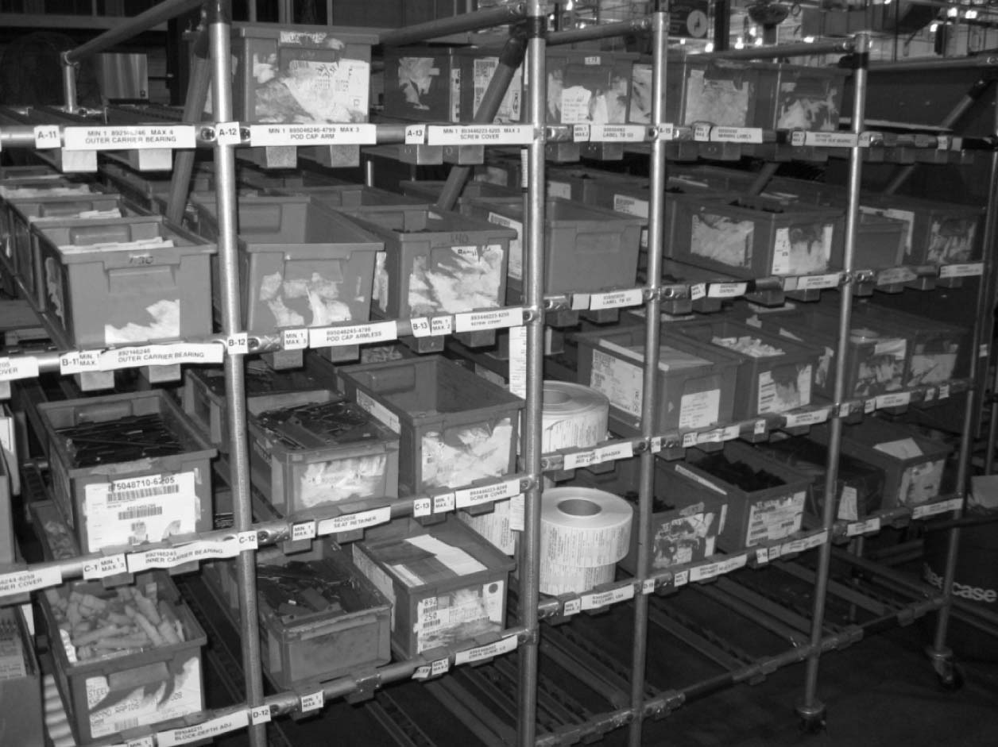
Bins in Rack Storage
Magal and Word | Integrated Business Processes with ERP Systems | © 2011

Slide 41
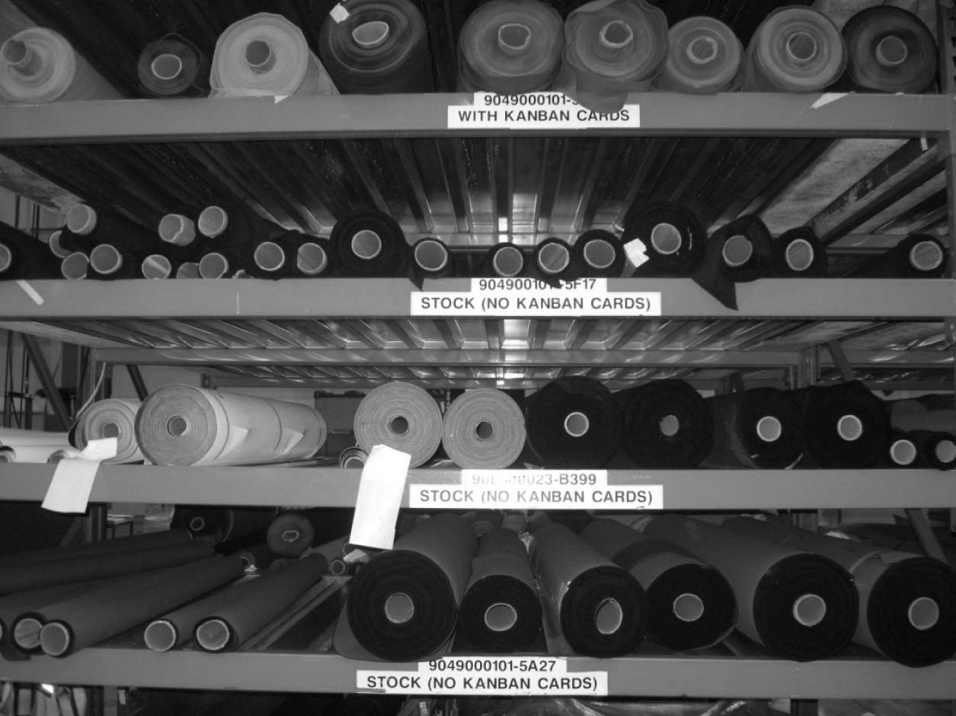
Fabric Storage
Magal and Word | Integrated Business Processes with ERP Systems | © 2011

Slide 42
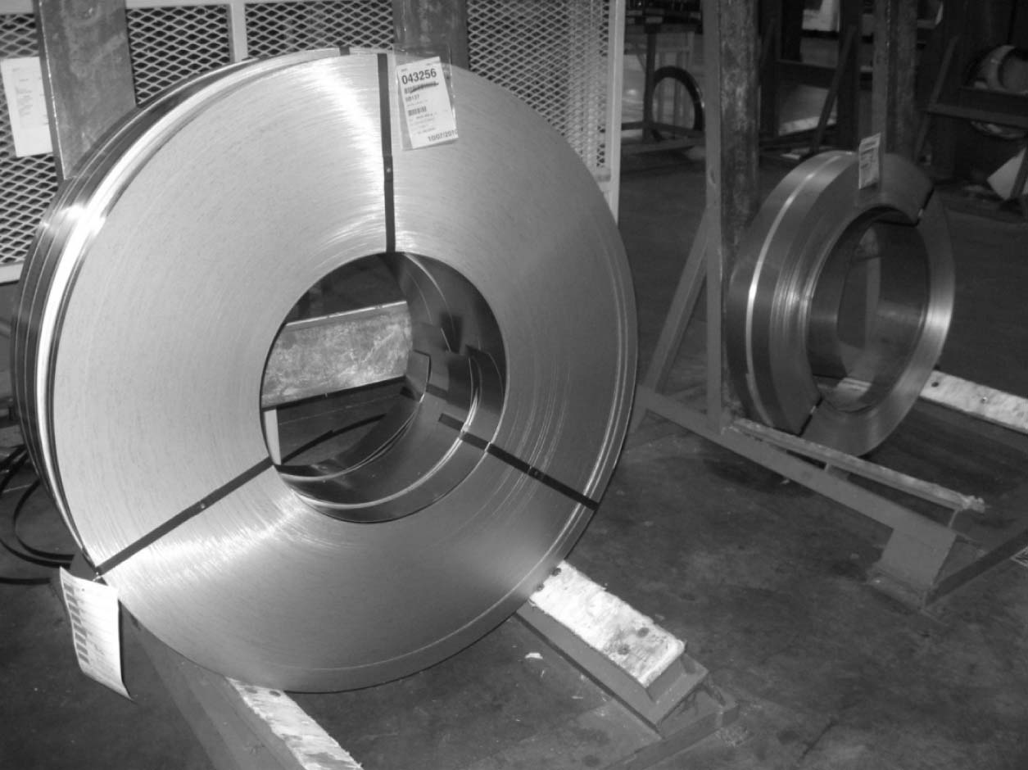
Rolled Steel Storage
Magal and Word | Integrated Business Processes with ERP Systems | © 2011

Slide 43
Master Data in Warehouse Management
Material master and storage bins are key master data.
Magal and Word | Integrated Business Processes with ERP Systems | © 2011

Slide 44
Material Master
Material master has been previously discussed in the context of several processes.
Material located in a storage location associated with warehouse management requires additional data in the material master.
Organization levels:
  Warehouse
  Plant
  Storage type
Magal and Word | Integrated Business Processes with ERP Systems | © 2011

Slide 45
Material Master
Warehouse management view:
  Basic data
  Data used in defining stock placement and removal strategies
  Data regarding the storage bins where the materials will be stored
Basic data are relevant to all processes.
Some data are redefined for warehouse management.
Placement and removal strategies
Bin-related data
Magal and Word | Integrated Business Processes with ERP Systems | © 2011

Slide 46
Demo 7-4 Review WM View of Material Master
Review warehouse management view of material master
Magal and Word | Integrated Business Processes with ERP Systems | © 2011

Slide 47
Storage Bins
Storage bins are the smallest unit of space in a warehouse.
Can vary in size
Unique address
Can store different materials (quants)
Magal and Word | Integrated Business Processes with ERP Systems | © 2011

Slide 48
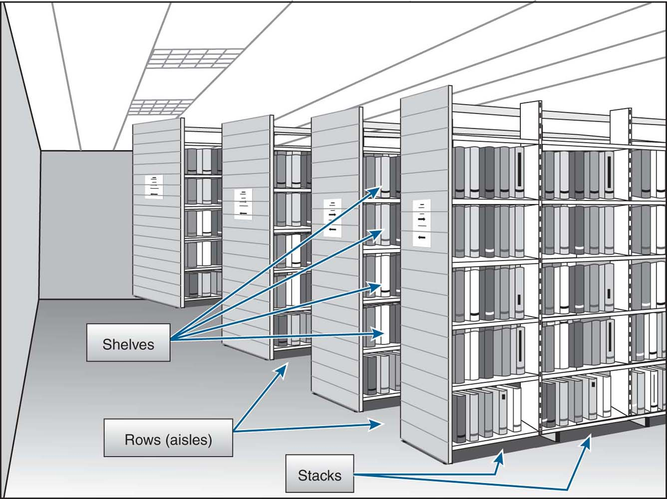
Storage Bin Addressing
Magal and Word | Integrated Business Processes with ERP Systems | © 2011

Slide 49
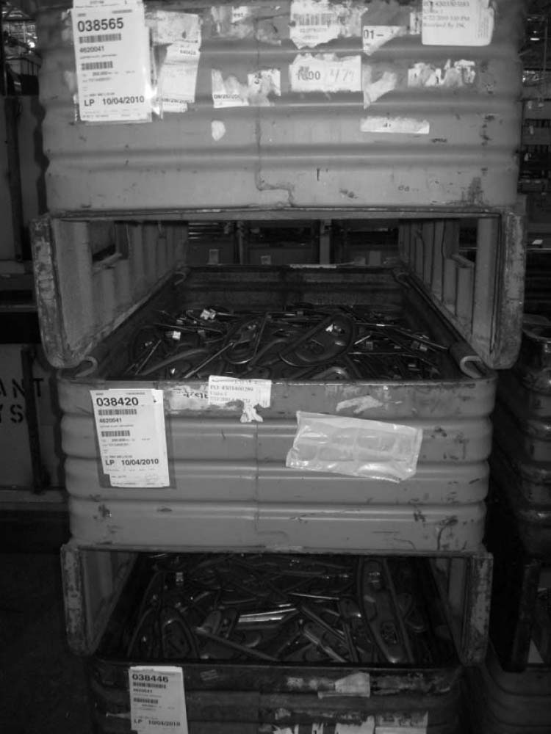
Storage Tubs (Bins)
Magal and Word | Integrated Business Processes with ERP Systems | © 2011

Slide 50
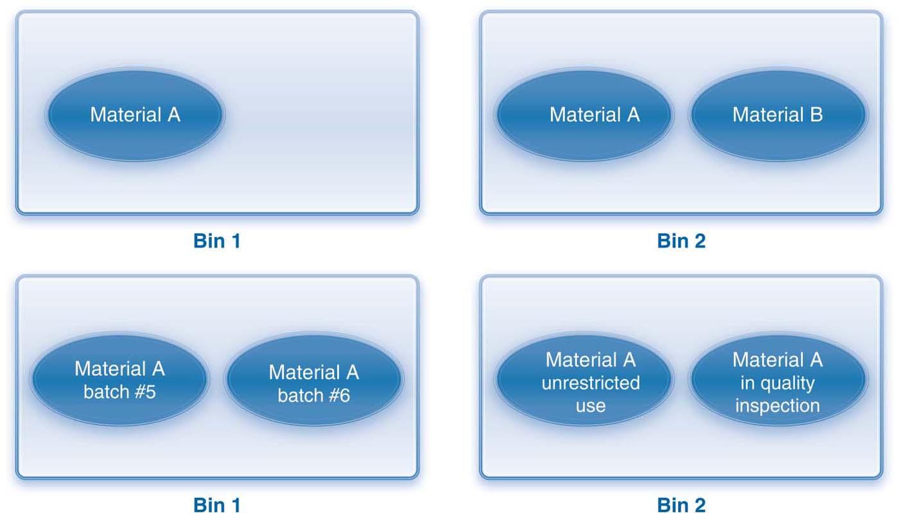
Quants in A Storage Bin
Magal and Word | Integrated Business Processes with ERP Systems | © 2011

Slide 51
Demo 7-5 Review storage bins, and display stock in storage bins
Review storage bins and display stock in storage bins
Magal and Word | Integrated Business Processes with ERP Systems | © 2011

Slide 52
Processes in Warehouse Management
The warehouse management process is typically triggered by goods movement in other processes such as:
  Procurement
  Fulfillment
  Production
  Inventory management
Transfer requirement is used to plan the movement of materials in and out of warehouse.
Movement of materials is accomplished with a transfer order.
Magal and Word | Integrated Business Processes with ERP Systems | © 2011

Slide 53
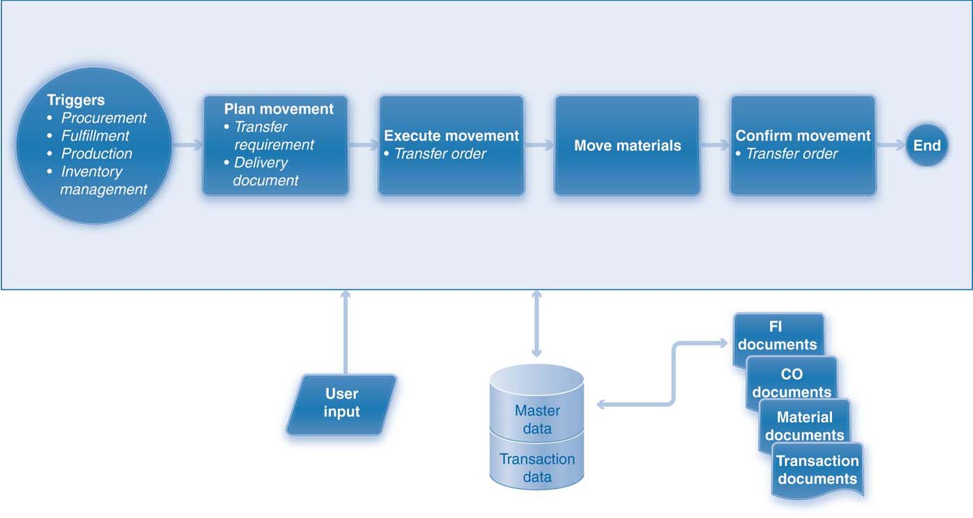
Warehouse Management Process
Magal and Word | Integrated Business Processes with ERP Systems | © 2011

Slide 54
Plan Warehouse Movement
Transfer requirement is generated automatically when goods movement involves warehouse-managed storage locations.
Transfer requirement is created manually to facilitate internal movement of materials.
Posting change notice is used to change the status of a material.
Source requirement for warehouse movement:
  Material document
  Delivery document
  Production order
No financial impact
Magal and Word | Integrated Business Processes with ERP Systems | © 2011

Slide 55
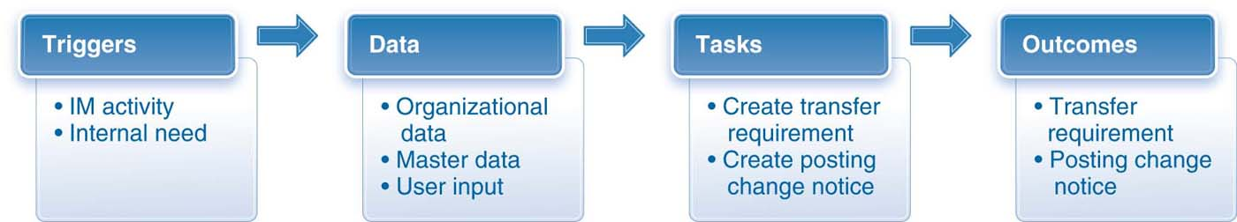
Elements of the Plan Warehouse Movement Step
Magal and Word | Integrated Business Processes with ERP Systems | © 2011

Slide 56
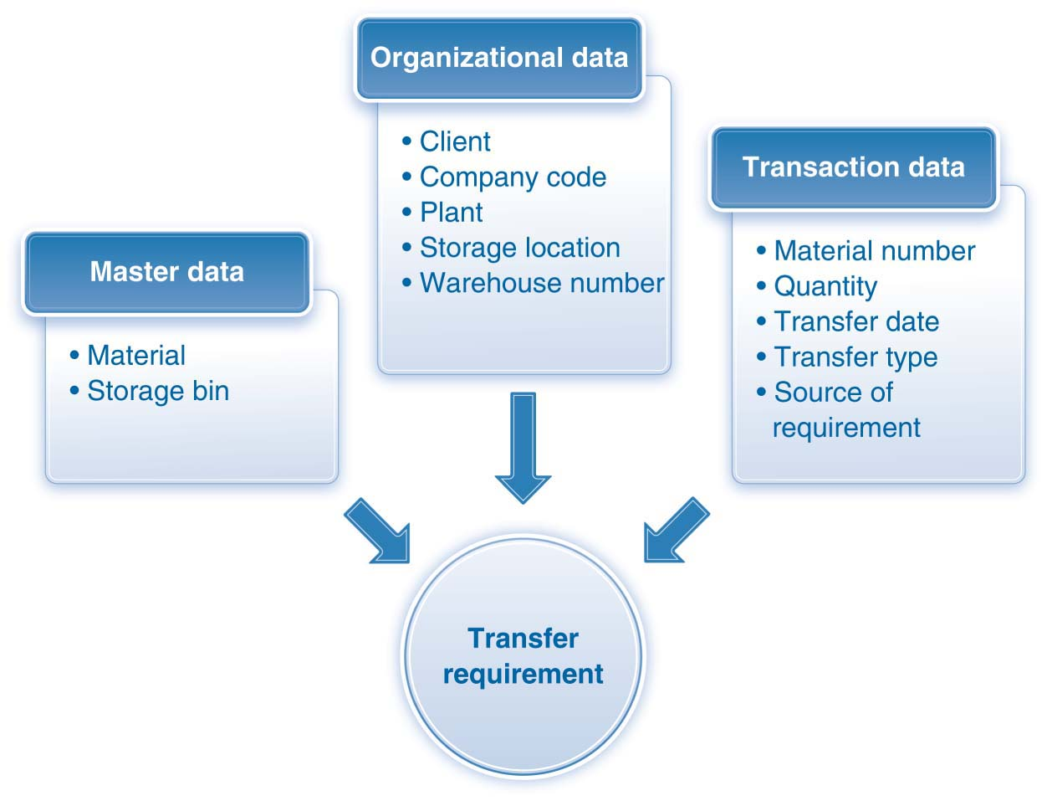
Data in a Transfer Requirement
Magal and Word | Integrated Business Processes with ERP Systems | © 2011

Slide 57
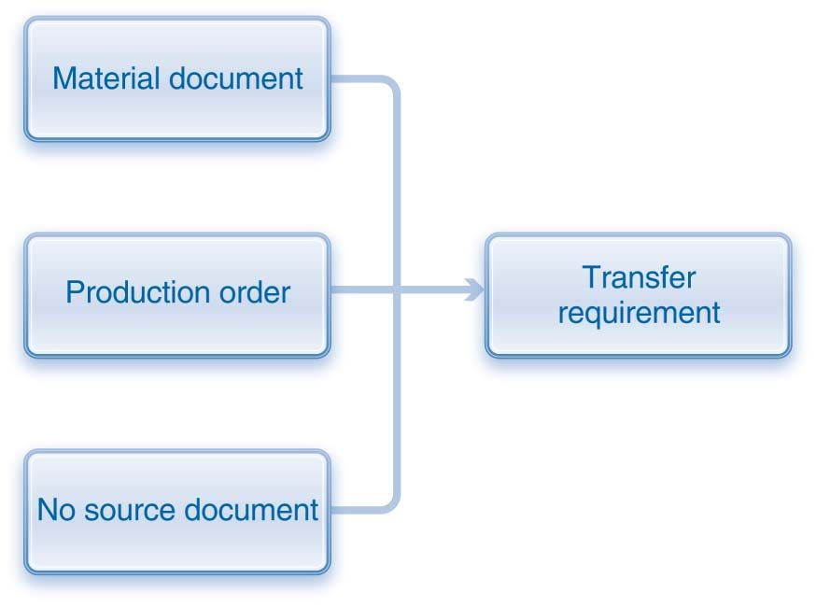
Reference Documents for a Transfer Requirement
Magal and Word | Integrated Business Processes with ERP Systems | © 2011

Slide 58
Execute Warehouse Movement
Common warehouse movements:
  Picking
  Putting away
  Posting changes
Transfer order is used to execute warehouse movement.
Transfer order can be created directly from transfer requirement or posting change notices.
Transfer order can be created manually to facilitate internal warehouse transfers.
Transfer order consists of a header and one or more line items.
No financial impact
Magal and Word | Integrated Business Processes with ERP Systems | © 2011

Slide 59
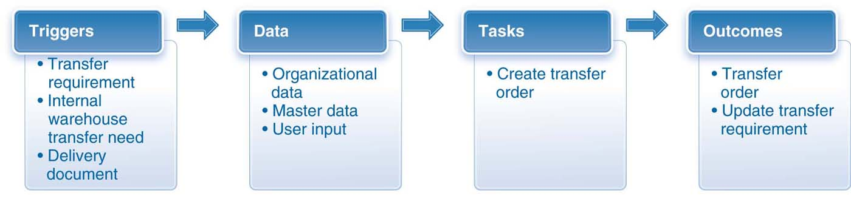
Elements of the Execute Warehouse Movement Step
Magal and Word | Integrated Business Processes with ERP Systems | © 2011

Slide 60
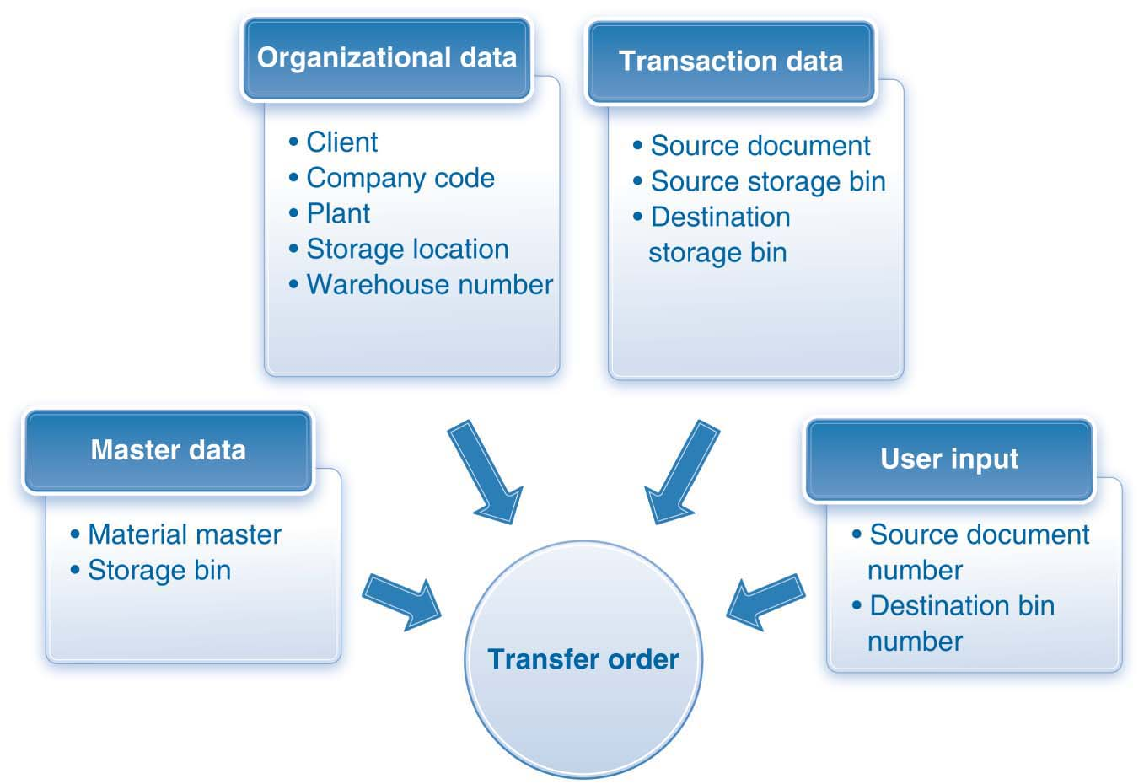
Data in a Transfer Order
Magal and Word | Integrated Business Processes with ERP Systems | © 2011

Slide 61
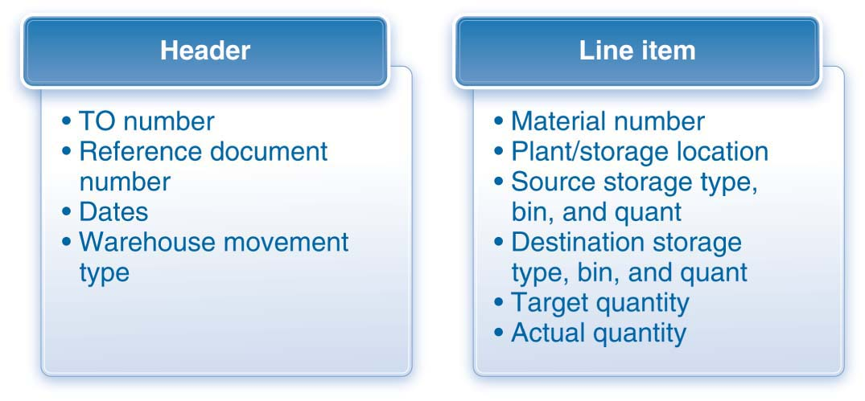
Structure of a Transfer Order
Magal and Word | Integrated Business Processes with ERP Systems | © 2011

Slide 62
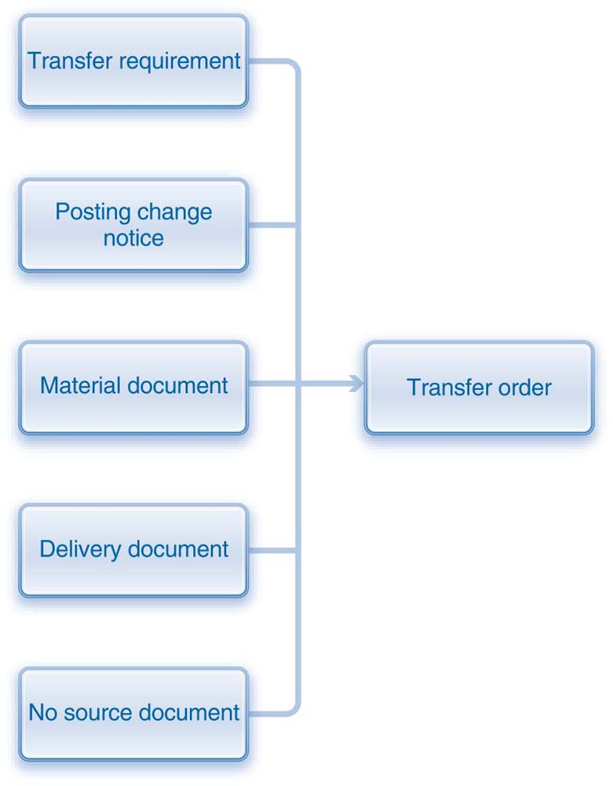
Reference Documents for a Transfer Order
Magal and Word | Integrated Business Processes with ERP Systems | © 2011

Slide 63
Confirm Warehouse Movement
Transfer order authorizes warehouse employees to physically move materials from source bin to destination bins.
  Once the materials have been moved, the movement is confirmed.
  The same transfer order created to authorize the physical movement of materials is used for confirmation
  ERP system automatically updates the associated reference documents such as :
    Delivery document
    Transfer requirement
    Posting change notice
Magal and Word | Integrated Business Processes with ERP Systems | © 2011

Slide 64
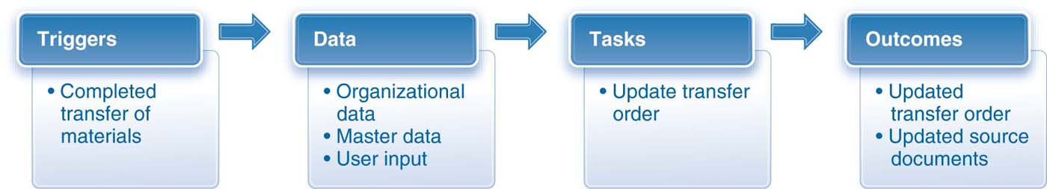
Elements of the Confirm Warehouse Movement Step
Magal and Word | Integrated Business Processes with ERP Systems | © 2011

Slide 65
Warehouse Management In Procurement
Plan warehouse movement
  Interim storage area is the physical link between the procurement and warehouse management processes.
  Transfer requirement is created.
Execute warehouse movement
  Ready to put away materials from interim storage area into warehouse bins.
  Transfer order is created.
Confirm warehouse movement
  Physically move materials from interim storage area into warehouse bins.
  Transfer order is updated with confirmed quantity and location.
Magal and Word | Integrated Business Processes with ERP Systems | © 2011

Slide 66
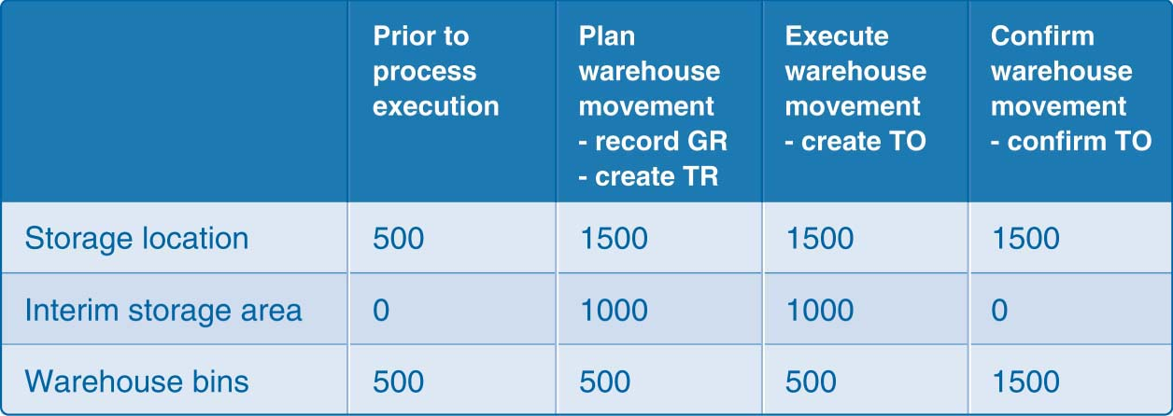
Inventory Impact - Procurement
Magal and Word | Integrated Business Processes with ERP Systems | © 2011

Slide 67
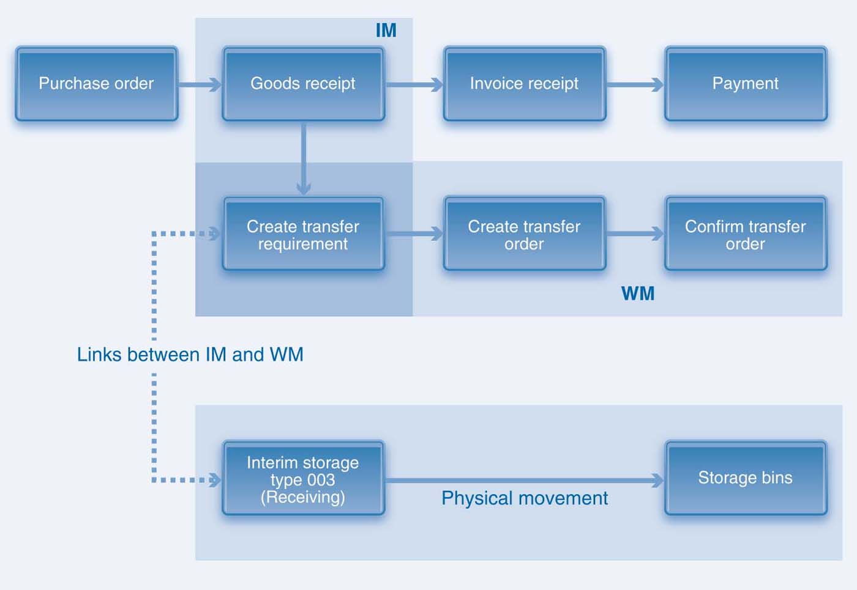
IM and WM Steps in Procurement
Magal and Word | Integrated Business Processes with ERP Systems | © 2011

Slide 68
Demo 7.6: Procurement Process with Warehouse Movements
Review the procurement process with warehouse movements
Magal and Word | Integrated Business Processes with ERP Systems | © 2011

Slide 69
Warehouse Management in Fulfillment
Plan warehouse movement
  Involves fulfillment processes and both inventory management and warehouse management processes
  Sales order generates a transfer requirement, which serves as the link between fulfillment processes and warehouse management processes
Execute warehouse movement
  Time to pick materials from warehouse
  Transfer order created based on transfer requirement
Magal and Word | Integrated Business Processes with ERP Systems | © 2011

Slide 70
Warehouse Management in Fulfillment
Confirm warehouse movement
  Materials have been picked from proposed bins and placed into interim shipping storage areas.
  Transfer order is updated with confirmed quantity picked and bins from which they were picked.
  Goods issue posted after materials have been shipped.
  Financial and controlling impact in inventory management.
  Fulfillment process continues through invoice and payment steps.
Magal and Word | Integrated Business Processes with ERP Systems | © 2011

Slide 71
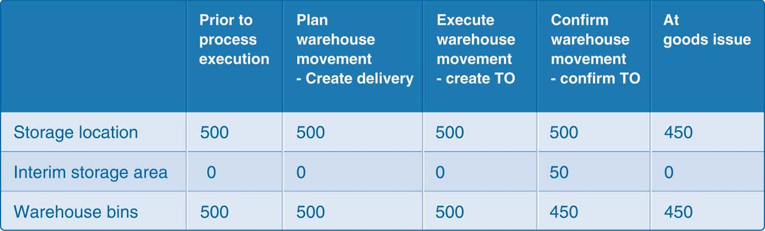
Inventory Impact - Fulfillment
Magal and Word | Integrated Business Processes with ERP Systems | © 2011

Slide 72
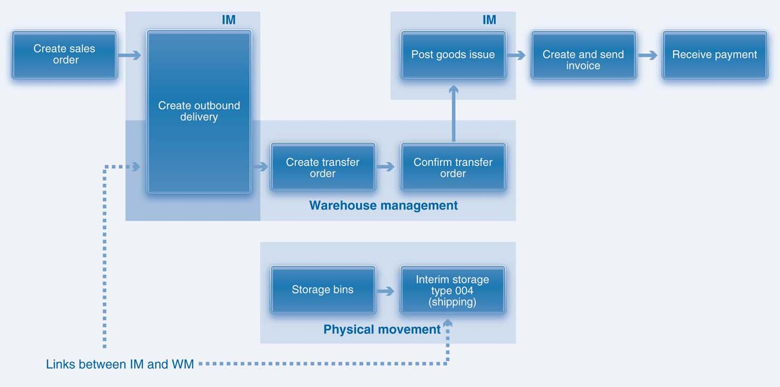
IM and WM Steps in Fulfillment
Magal and Word | Integrated Business Processes with ERP Systems | © 2011

Slide 73
Demo 7.7: Fulfillment Process with Warehouse Movements
Review the fulfillment process with warehouse movements
Magal and Word | Integrated Business Processes with ERP Systems | © 2011

Slide 74
Warehouse Management in Production
Involves both goods issue (production) and goods receipt (storage).
Production order generates a transfer requirement.
Transfer order is created for materials placed into interim storage area.
Goods issue has a financial impact and material outcomes.
After the production process has been completed and confirmed, finished goods are placed into warehouse bins.
Transfer order is created and confirmed after the finished goods are placed into warehouse bins.
Magal and Word | Integrated Business Processes with ERP Systems | © 2011

Slide 75
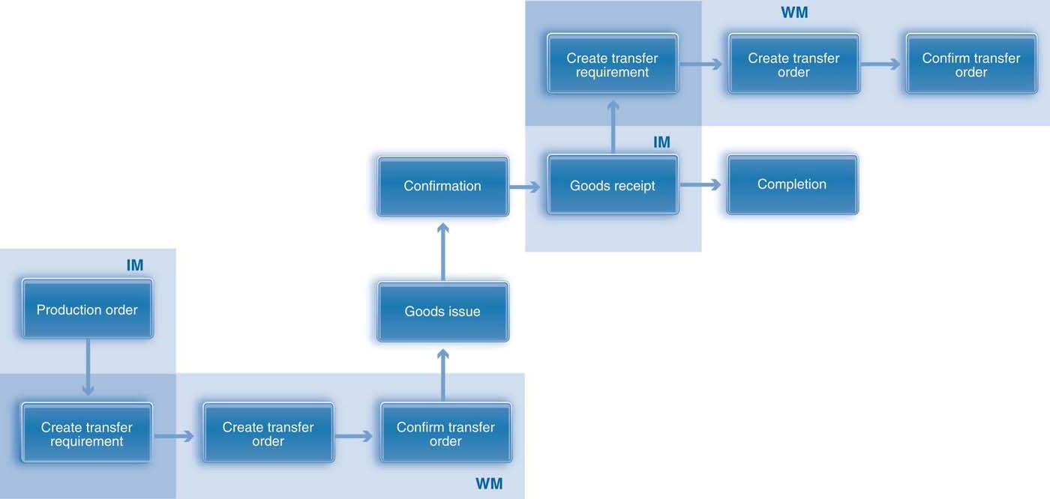
IM and WM Steps in Production
Magal and Word | Integrated Business Processes with ERP Systems | © 2011

Slide 76
Warehouse Management in Stock Transfers
Warehouse management activities can be initiated by stock transfers and transfer postings.
Transfer requirements are automatically generated by ERP system when goods movement involves warehouse management storage locations.
Material documents are created when IM activities involve goods issue and goods receipt; they may result in a financial impact
No FI impact generated by an internal transfer between storage locations within same warehouse.
Magal and Word | Integrated Business Processes with ERP Systems | © 2011

Slide 77
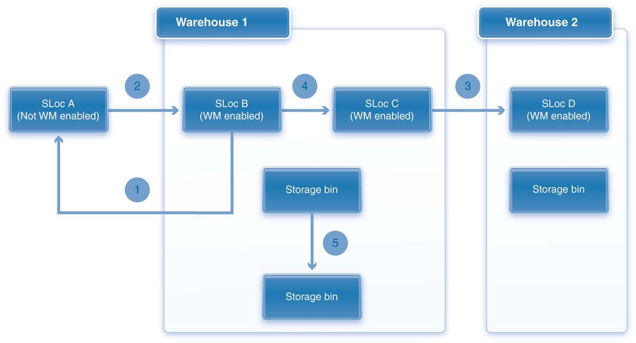
WM Scenarios for Stock Transfers
Magal and Word | Integrated Business Processes with ERP Systems | © 2011

Slide 78
Demo 7.8: Internal Warehouse Transfer
Review the internal warehouse transfer
Magal and Word | Integrated Business Processes with ERP Systems | © 2011

Slide 79
Order of Postings in WM and IM
Posting in warehouse management and inventory management by which the order inventory management and warehouse management activities are completed can vary from one scenario to another
  Goods issue in inventory management for a sales order or production posted before warehouse management activities confirmed
  Put away in warehouse management is before goods receipt posted in inventory management
Magal and Word | Integrated Business Processes with ERP Systems | © 2011

Slide 80
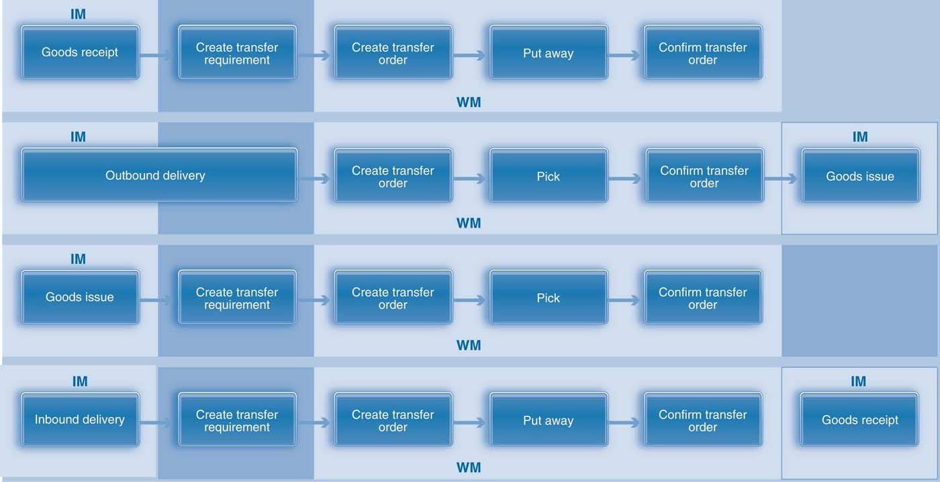
Scenarios for WM and IM Activities
Magal and Word | Integrated Business Processes with ERP Systems | © 2011

Slide 81
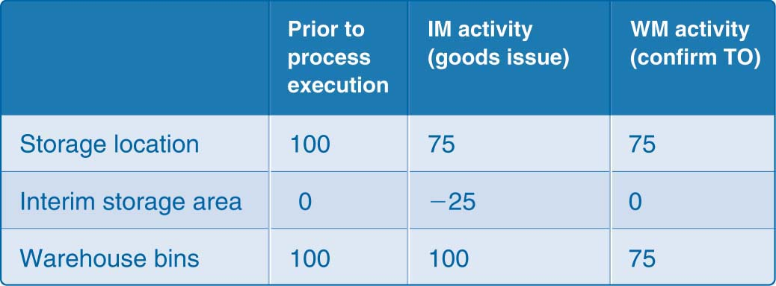
Inventory Impact When IM Precedes WM
Magal and Word | Integrated Business Processes with ERP Systems | © 2011

Slide 82
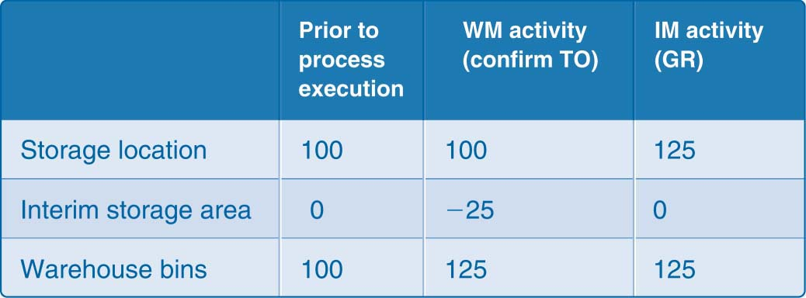
Inventory Impact When WM Precedes IM
Magal and Word | Integrated Business Processes with ERP Systems | © 2011

